Slide 1



Data Acquisition & Data Wrangling
Alankar Saxena

Slide 2
Introduction
Data Acquisition- Data Acquisition is the process of collecting, measuring, and storing data from various sources.
It can be from online sources, databases, manual inputs etc. The primary goal of data acquisition is to gather useful and relevant data to extract meaningful insights.
Data Wrangling- It is the process of cleaning and restructuring the acquired data and transform it to more suitable format for analysis and extracting meaningful insights.
The process includes cleaning the data, correcting/removing inaccuracies and restructuring data.

Slide 3
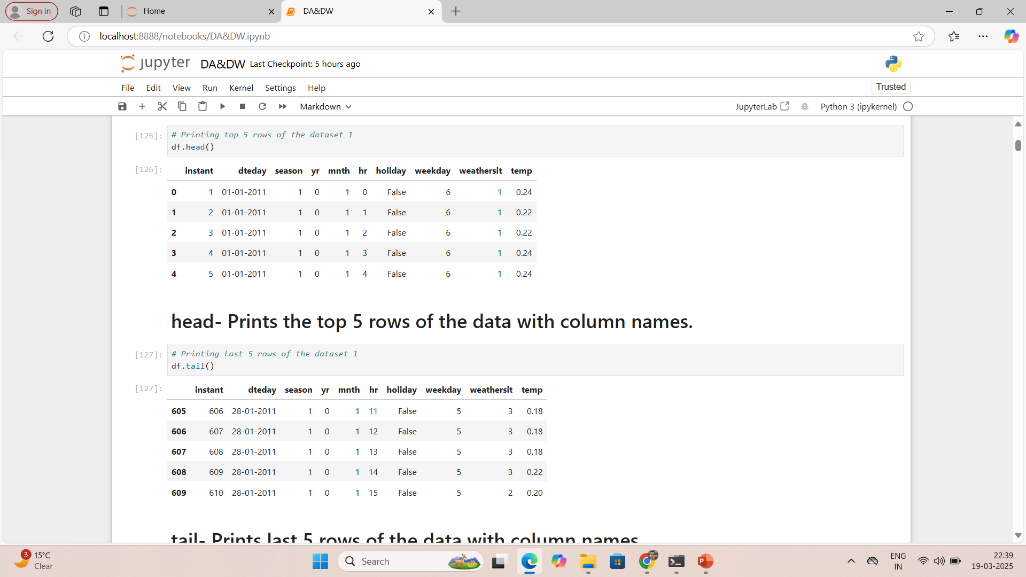
Dataset-1- It has data of January month of 2011 with values of temperature, weather type, weekday, holiday, hour of the day and dates.

Slide 4
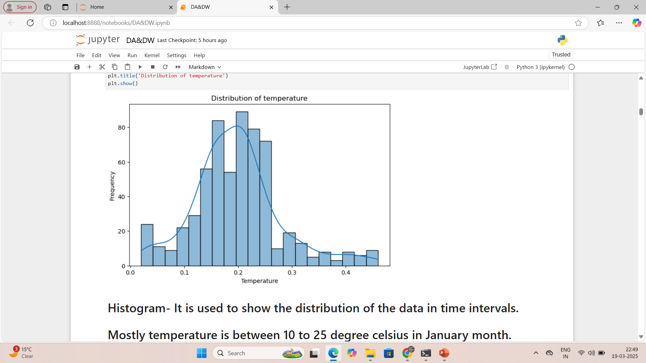
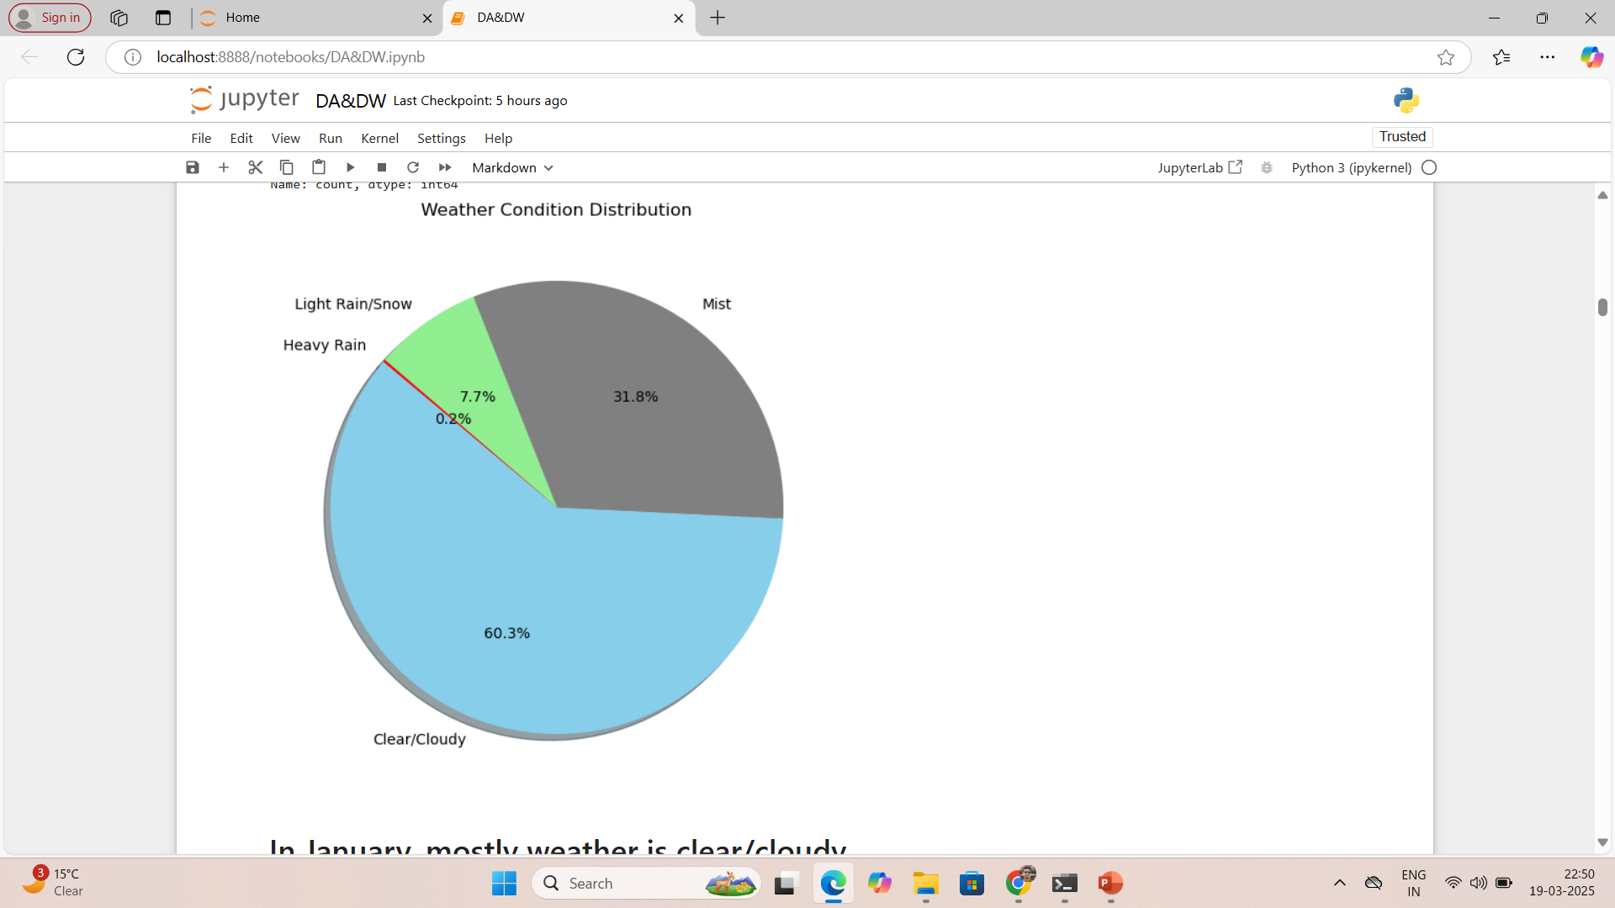
Mostly temperature in January month is between 10 to 25 degree Celsius.
Rainy and snowy days are very less in January month with heavy rain on only one day in whole month.

Slide 5
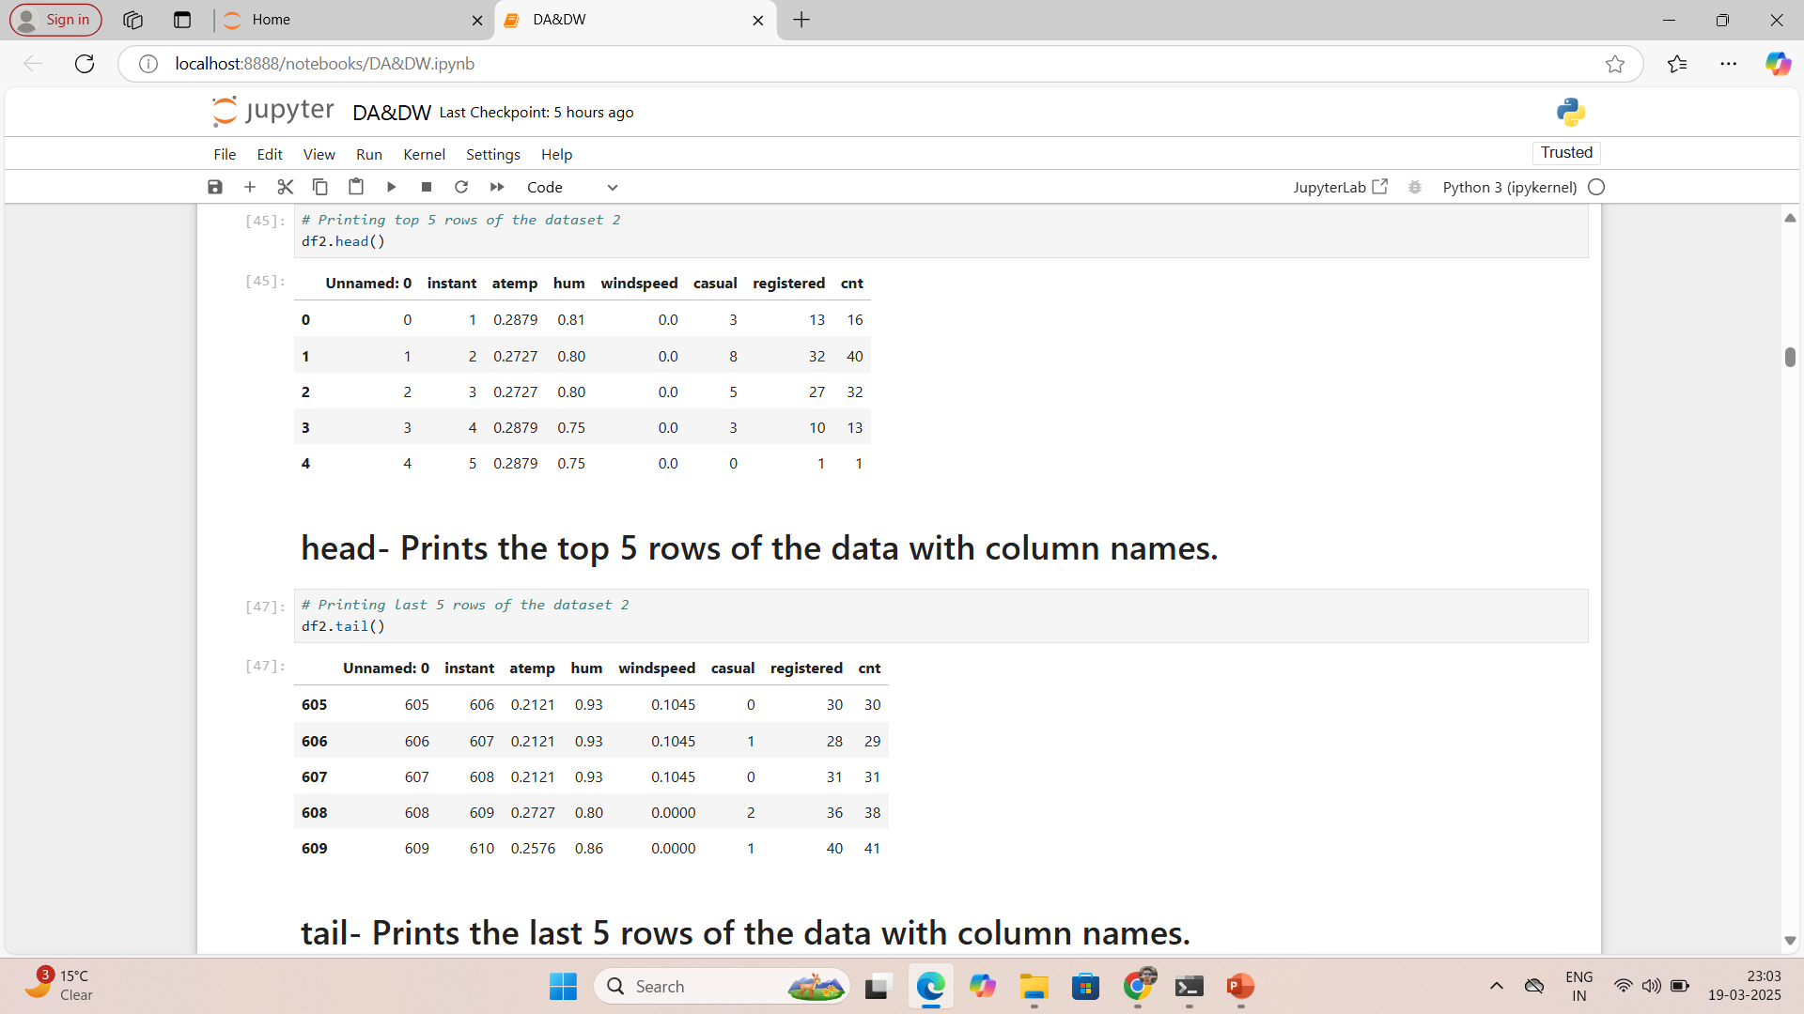
Dataset-2- It has data of actual temperature, humidity, windspeed, casual bike rentals, registered users bike rentals and total bike rentals(casual+registered).

Slide 6
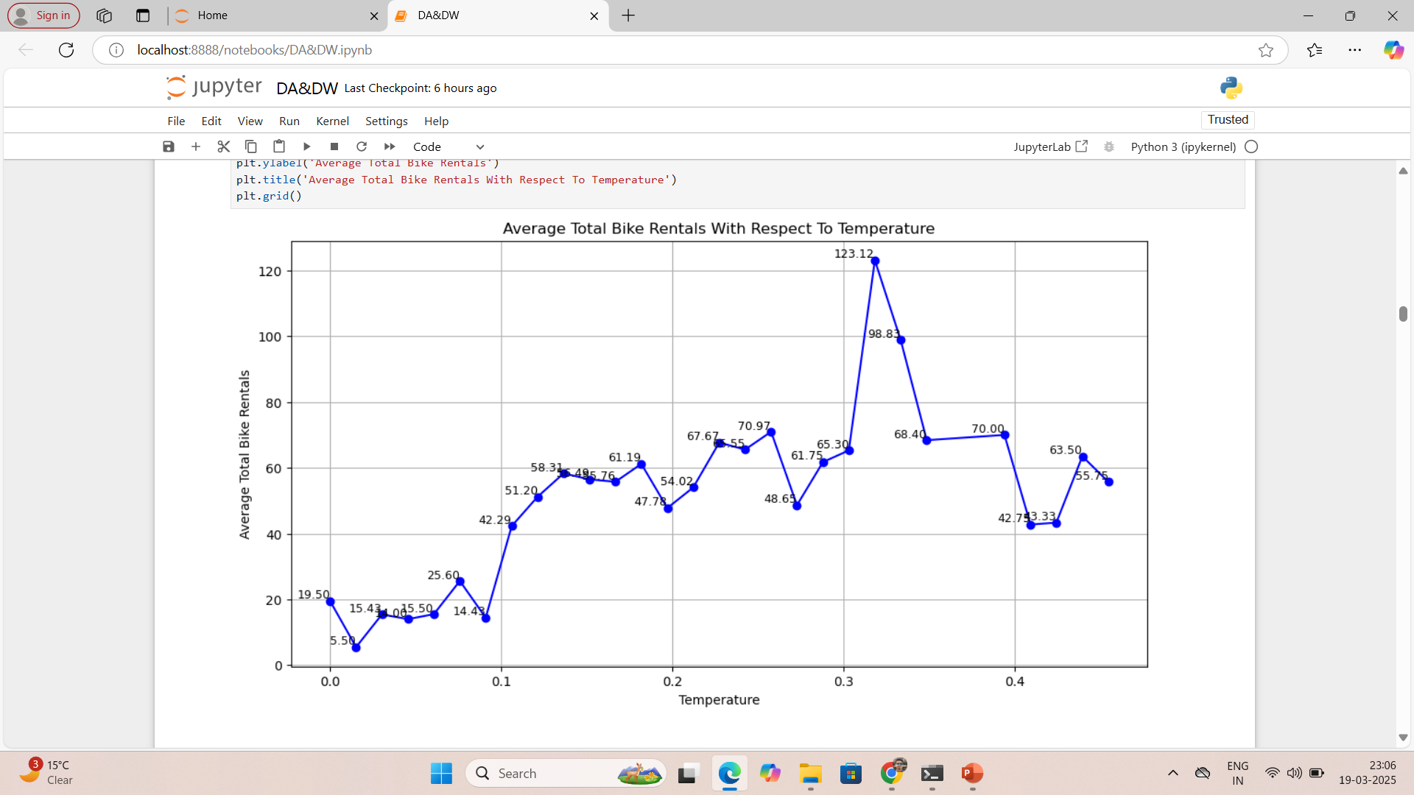
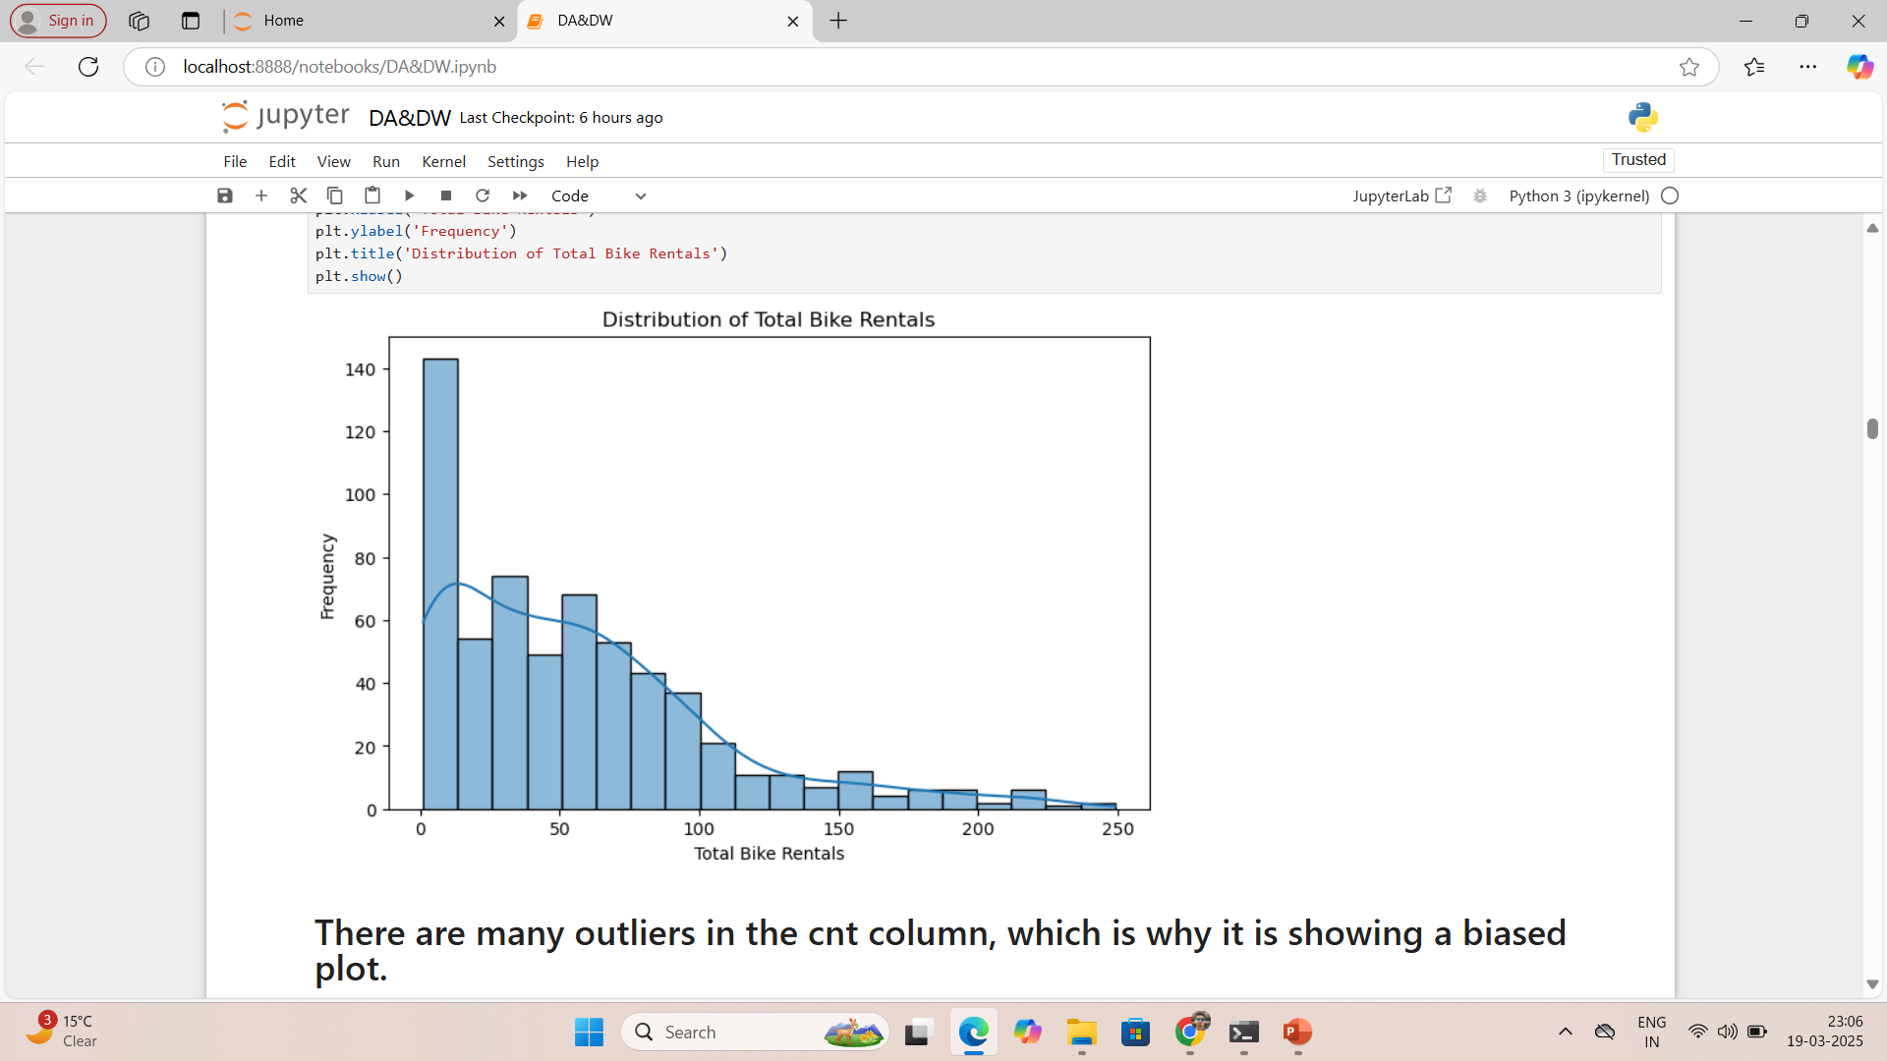
Average total bike rentals increases with increase in temperature till temperature reaches around 32 degree Celsius.
Most bike rentals are occurring when temperature is between 20-40 degree Celsius.
Distribution of total bike rentals column is on left side, which means it is very asymmetric.

Slide 7
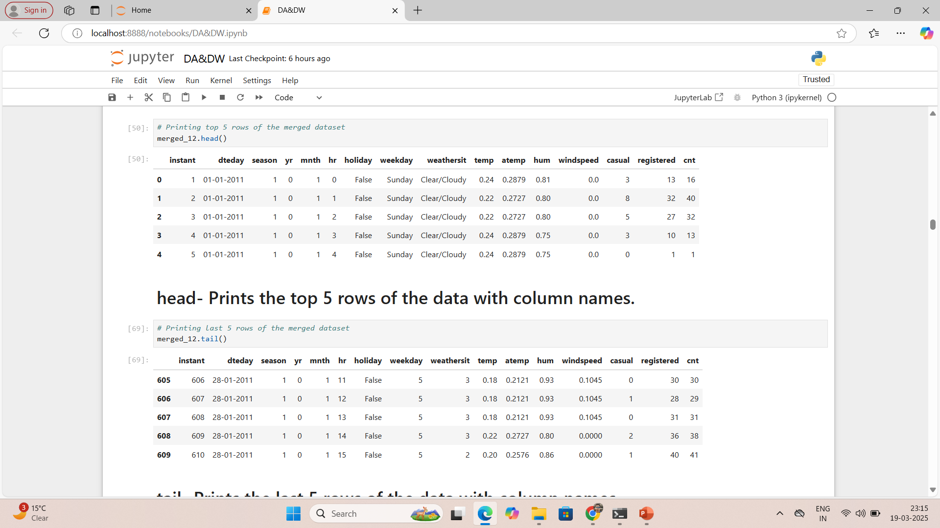
Merged_12- It is the merged data of dataset-1 and dataset-2 with common column instant.

Slide 8
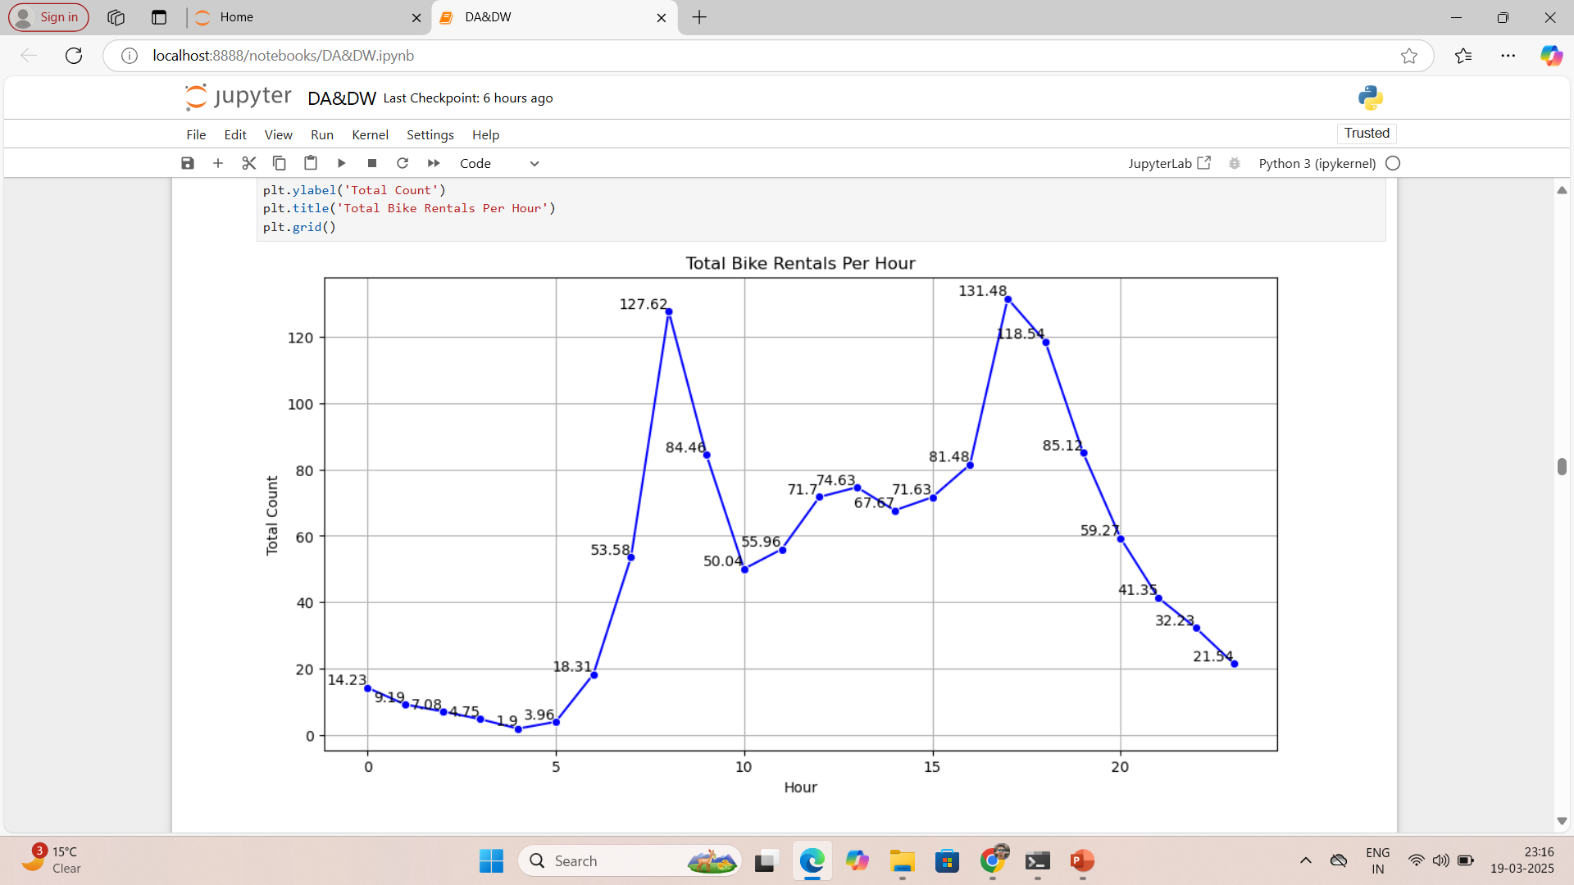
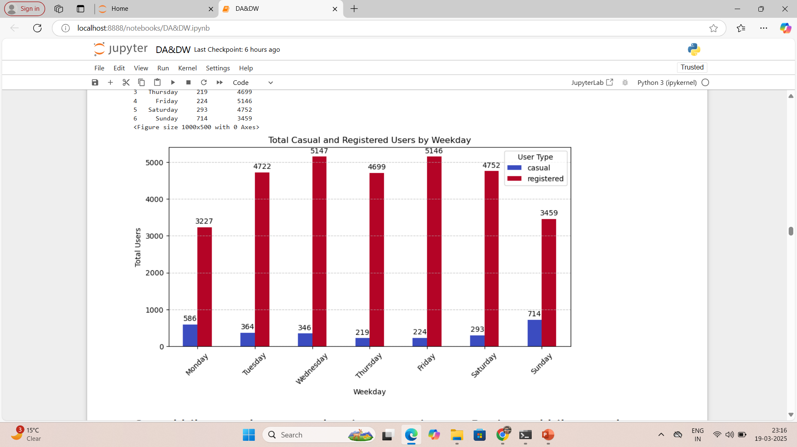
Average total rentals are high in day time and very low in night and early morning time.
Casual bike rentals are very low in comparison to registered users rentals.

Slide 9
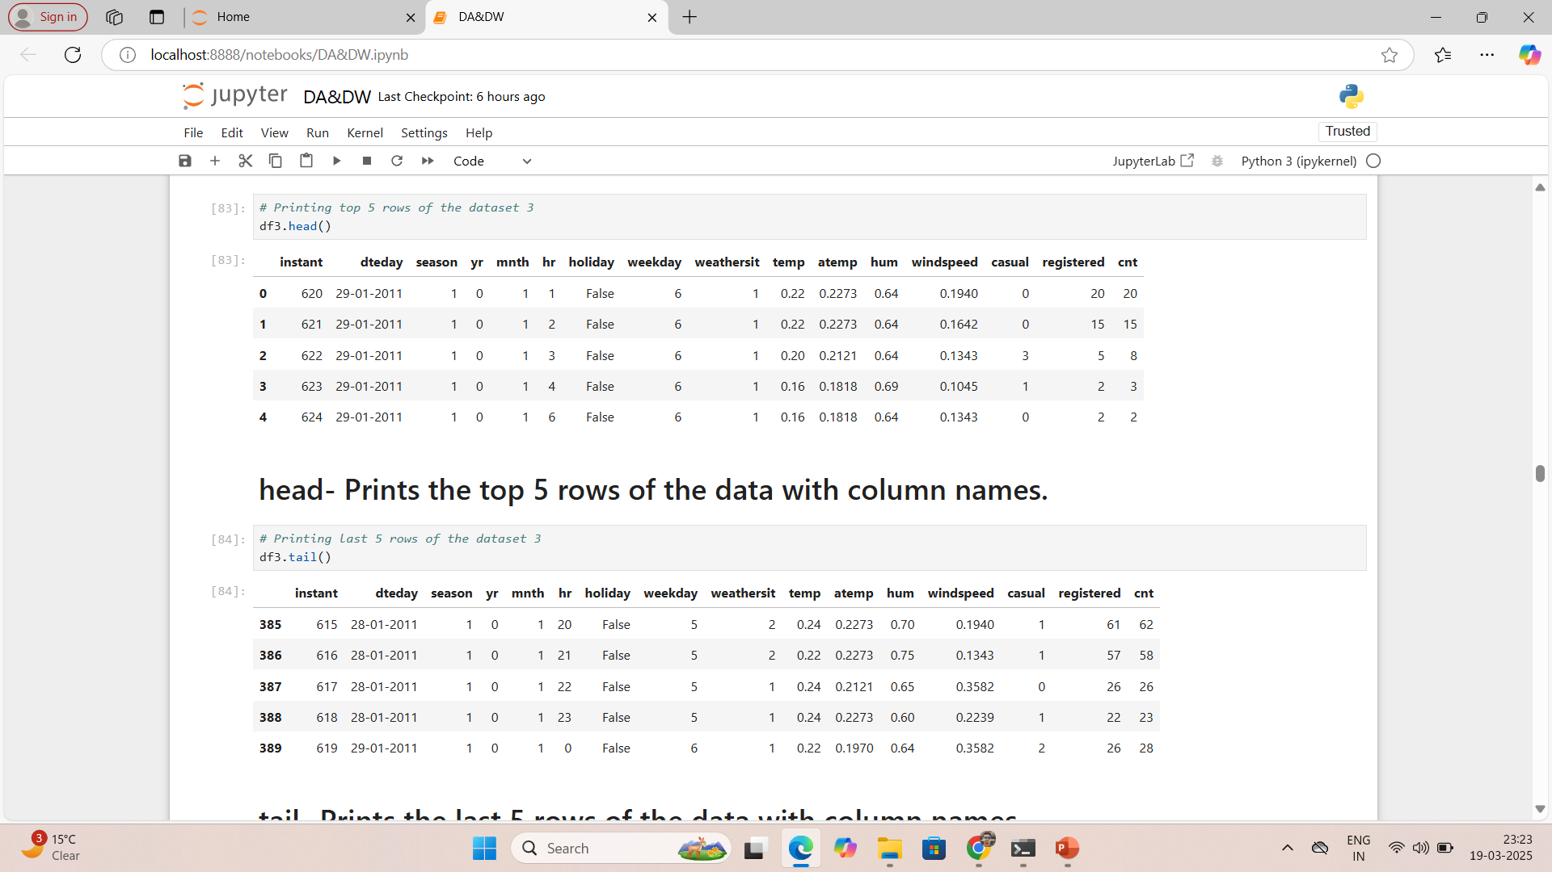
Dataset-3- It has data of temperature, weather type, weekday, holiday, hour of the day and dates, actual temperature, humidity, windspeed, casual bike rentals, registered users bike rentals and total bike rentals(casual+registered) of few January days and first 14 February days of 2011.

Slide 10
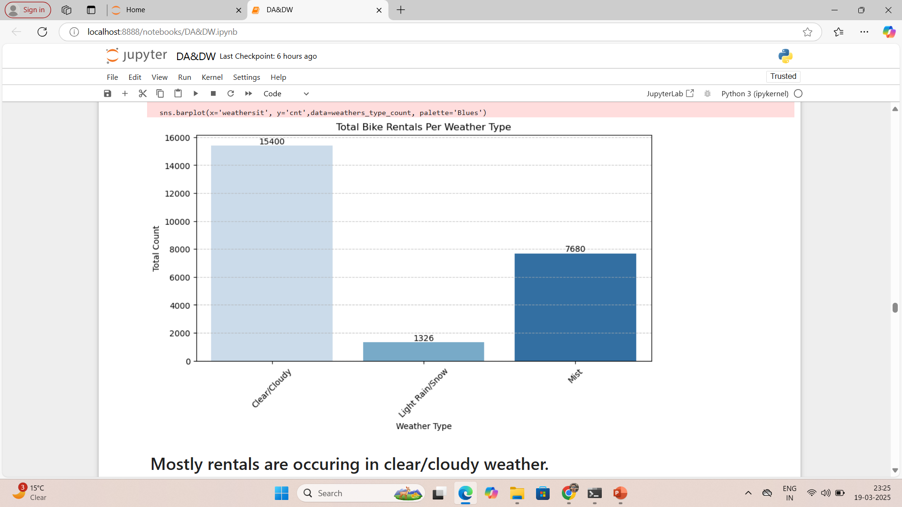
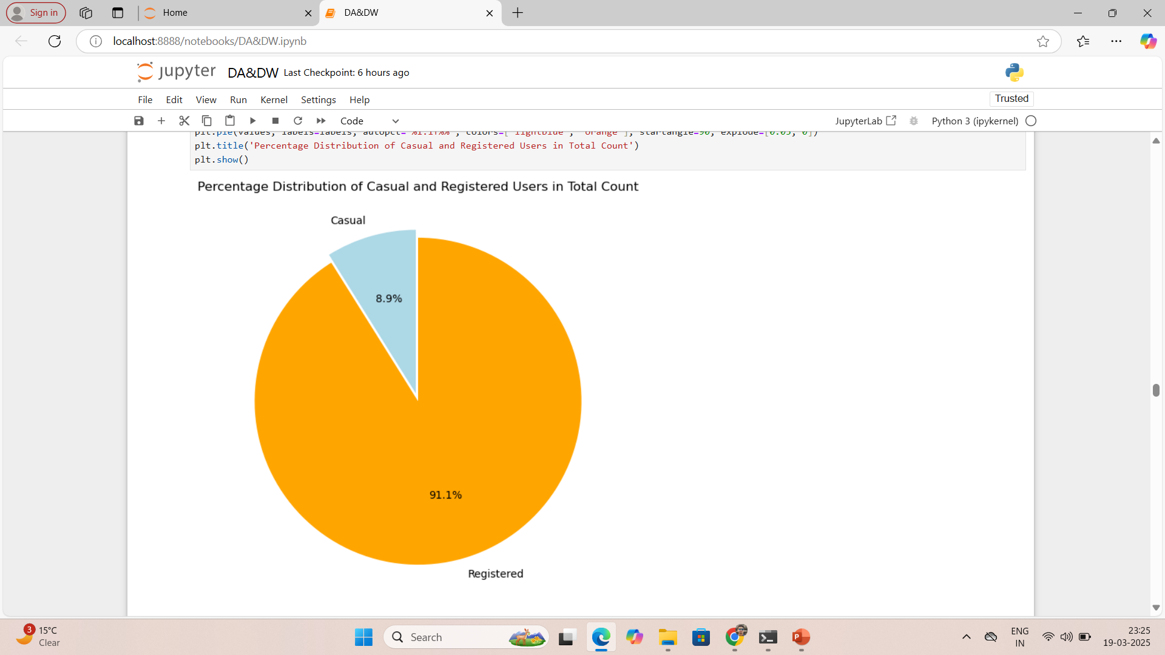
Mostly rentals are occurring in clear or cloudy weather.
There is no rental in heavy rain and very few rentals in light rain and snow.
The contribution of casual rental bookings is very low in total rental bookings.

Slide 11
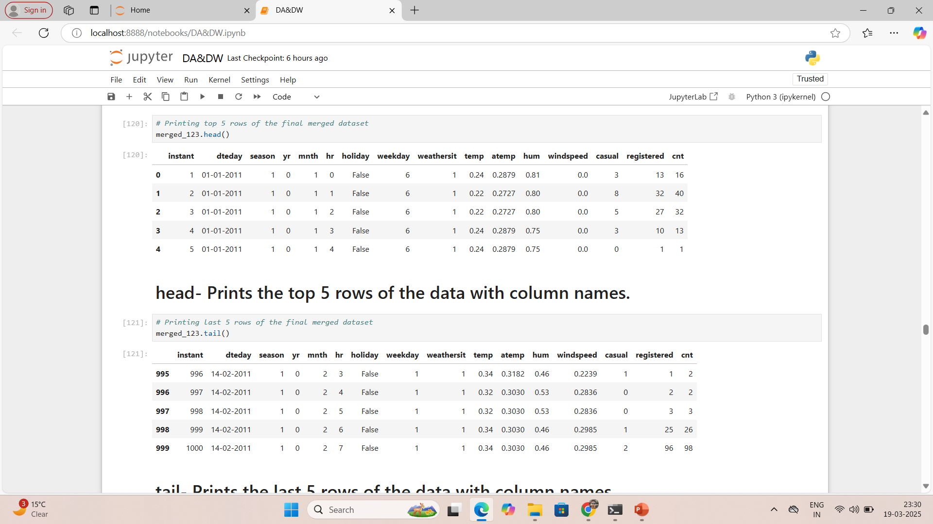
Merged_123- It is the merged data of dataset merged_12 and dataset-3 with common column instant.

Slide 12
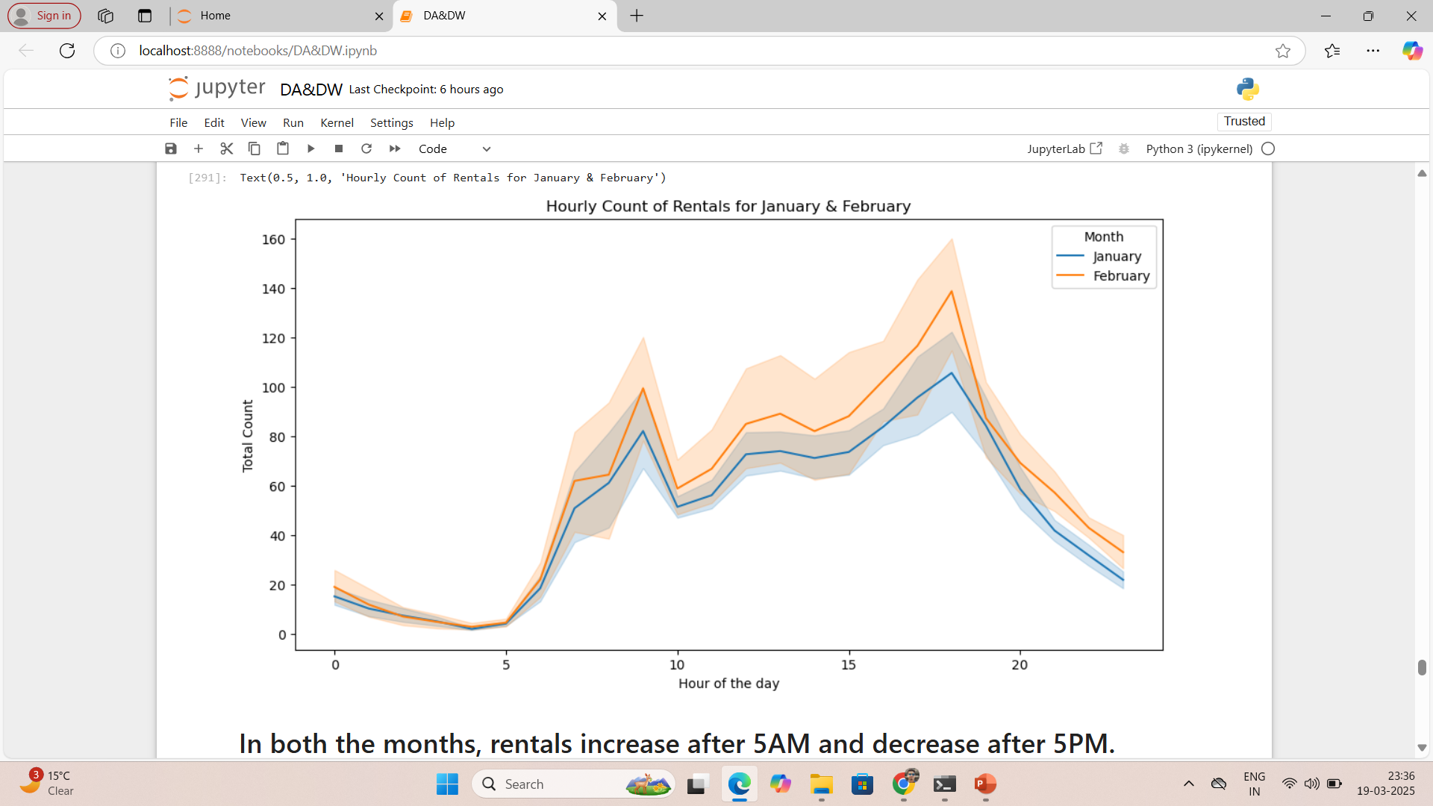
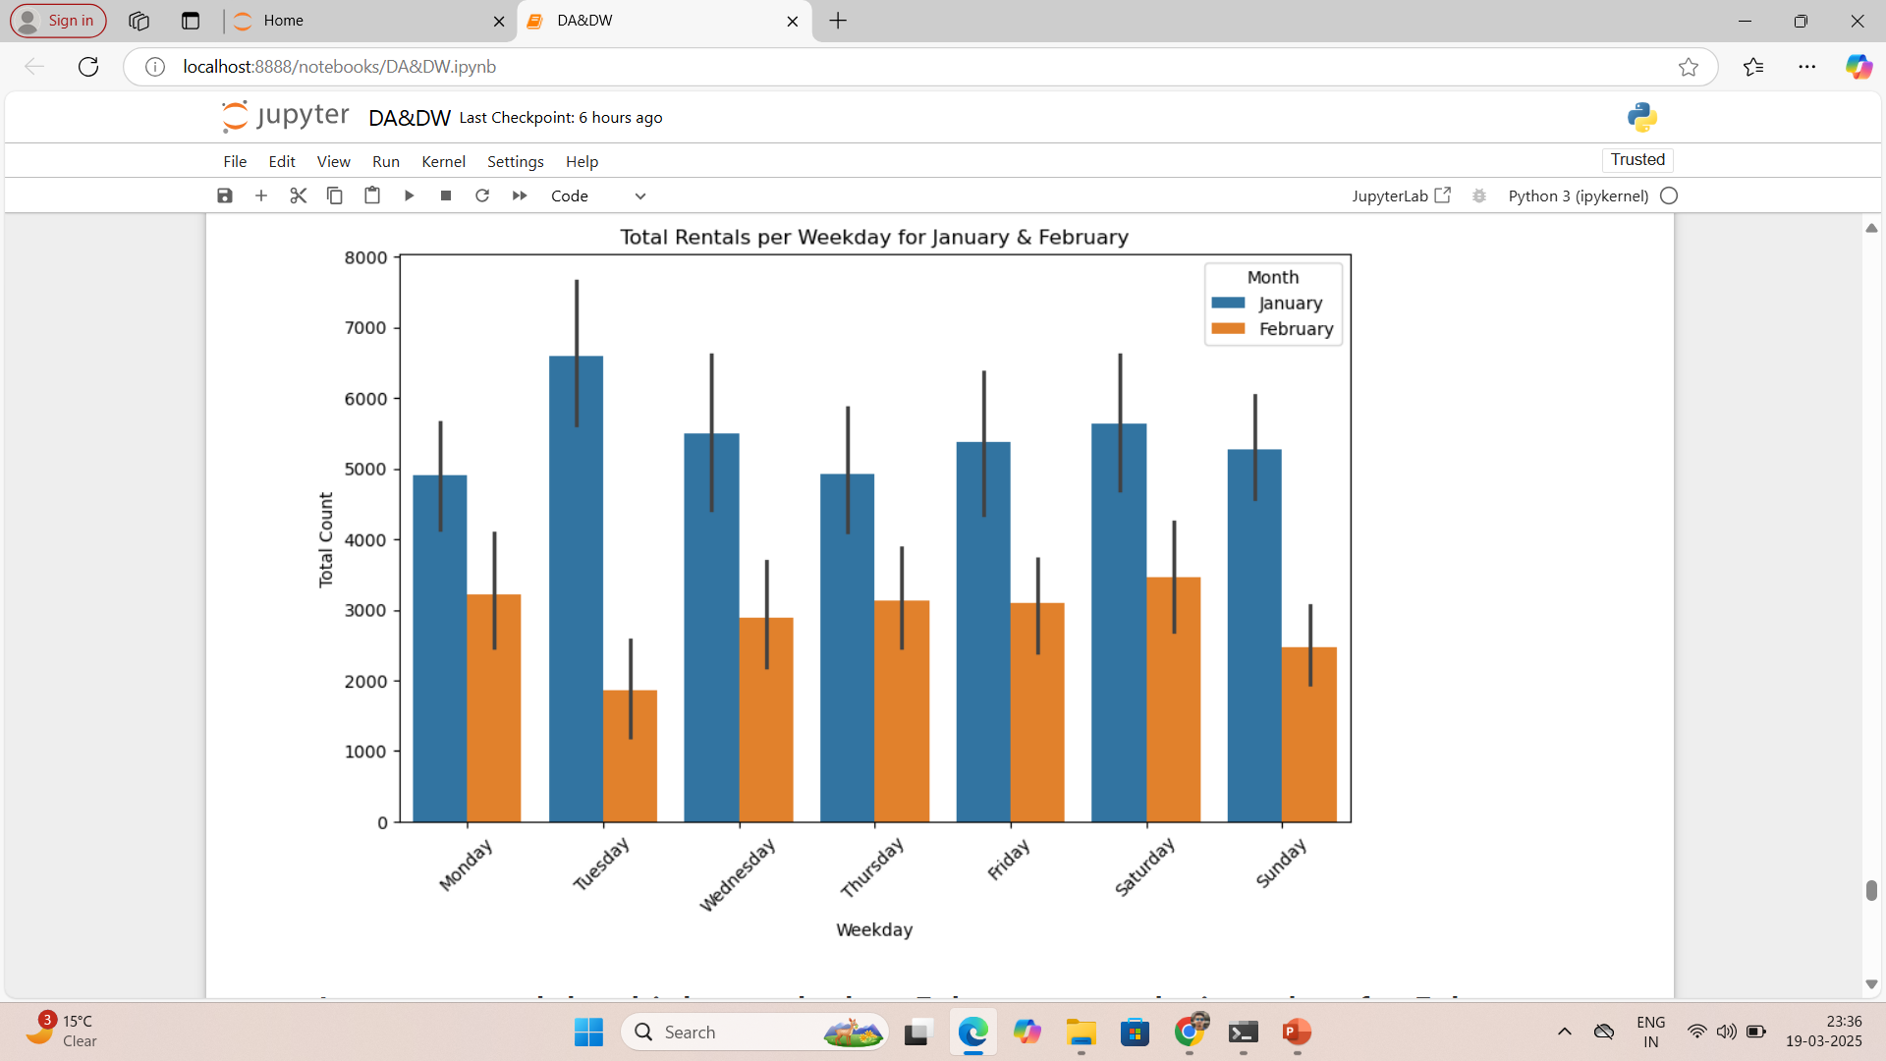
In both months, January and February, total bike rentals are mostly occurring in day time i.e. between 5 AM to 5 PM.
Total rentals are quite high in February than in January.
Total rentals are more in January as there is whole month data available of January.
On Tuesday, rentals are very high and maximum throughout the weekdays in January but in February, rentals are very low and minimum on Tuesdays.

Slide 13
Reference
https://www.geeksforgeeks.org/what-is-data-acquisition-in-machine-learning/
https://www.geeksforgeeks.org/data-visualisation-in-python-using-matplotlib-and-seaborn/
https://www.geeksforgeeks.org/python-pandas-dataframe-skew/

Slide 14
THANK YOU
By-
Alankar Saxena

